Slide 1
Teapot Dome Scandal
By: Sydney Taylor

Slide 2
Official Story
The Teapot Dome Scandal occurred in the 1920s when big business and scandal ran wild. This is the second biggest scandal in American government history, second only to Nixon’s Watergate Scandal. The Navy had asked Congress to set aside oil reserves for only the Navy’s use and only in times of emergency, which Congress approved. One of these reserves was the Teapot Dome. Just after Harding was elected president in 1920 and appointed Albert Fall as his Secretary of Interior, he asked Harding to let him handle the transfer of all Naval oil which Harding approved. After Fall had the Navy’s oil in his possession he made secret deals with two prominent oilmen, Edward Doheny and Harry Sinclair. Both men paid him bribes to authorize them to drill in the three naval petroleum reserves. When they were found out when the governor of Wyoming noticed Sinclair’s trucks and told Congress who sent a special research team. Fall was tried and found guilty of collecting bribes and sent to jail.

Slide 3
Background of the Conspiracy
There is only one conspiracy theory about the Teapot Dome Scandal, since we all know, in fact, that it did happen. Around the same time that Kendrick reported his suspicions to the special senate investigation committee, Grant took a holiday leave out West. Some say this could have been to discreetly check what was happening in Wyoming where the Teapot Dome was while others say that that is not possible because he had no clue what Fall was doing with the Naval reserves oil. Another conspiracy is that while Harding was taking his vacation out West he passed away. He died suddenly and there was never any testing done on him but some say that it was his way out of jail and that he did know what was happening the entire time.

Slide 4
Government Reaction to the Story
When the governor of Wyoming, where the Teapot Dome oil reserve is located, noticed more and more of Sinclair’s trucks with the oil drilling logo on them he became more and more suspicious. Miller realized that they were going into the area reserved for only the Navy’s use. Miller’s first reaction was to do and tell another person because he was suspicious of the activity and could tell that it was wrong. He told United States Senator John B. Kendrick. Kendrick also realized that there was wrong doing going on in Wyoming and also confided in the special senate investigation committee who after investigation agreed with both men that people were working against the government. The government was very relieved to have Fall out of office because he was corrupt and doing bad things to the Harding administration.

Slide 5
Media’s Reaction to the Story
There still wasn’t much of a media back in the 1920’s, at least not the kind of media we think of today. Today if anything happens in a celebrities life magazines and blogs publish it almost before it even happens. But back then we were still using newspapers and there were few monthly magazines too. But the media of the early 1920’s knew that the Harding administration would be published frequently. The Harding administration was plagued with scandal after scandal, so when the media heard about another possible scandal in 1921 in Wyoming, they jumped on the chance to get another story that would boost their careers as well as show more of the Harding administrations flaws.

Slide 6
Popular Reaction to the Story
The people of the 1920’s are known for their scandals as well. But they were not in the spotlight and didn’t have to worry about as many other people finding out. When word of the Teapot Dome Scandal reached the average Joe, after the government and the press had got ahold of the story, they most likely made it worse than it really was. People were appalled that the leader they had elected into office would cause so much corruption and so many problems. They were angry with Fall because they felt by accepting bribes and letting them drill on oil lands for the Navy, that he was against the United States. The people loved the military after just getting out of World War I and would protect them from corruption like Fall.

Slide 7
Power Structures that Caused Conspiracy
During the time of the 1920’s, the bubble before the Great Depression was growing rapidly. There was a lot of prosperity for many but some were still stuck in poverty and low wages. The Standard Oil Company founded by Rockefeller in the 1870’s ended in 1911 but the affects were still felt by those in the oil industry. Standard Oil had many connections and had drilled up a lot of the available oil. Therefore, men who were trying to develop their oil industries to be as big as Rockefeller’s were struggling. Also Albert Hall was inexperienced and was only a friend of Harding’s so any chance at extra money he was getting he was most likely going to take. So even though it’s not right, Doheny and Sinclair’s bribes make sense.

Slide 8
Habits of People
During the decade of the 1920’s, many people were expanding from traditions, especially the young teens and adults. Bootlegging, due to the period of prohibition, caused a lot of scandal among everyday citizens. Bootleggers would make and sell their own alcohol for high profits. Also, during this period of prohibition, many Americans looking for profit created speak-easies. These were private clubs for young men and women to party and drink alcohol without the fear of being arrested. So when the Teapot Dome Scandal reached the ears of the average Americans they could relate somewhat with the Harding administration scandal due to their corruption with the making and selling of alcohol.

Slide 9
Time Period Events
More population in cities and urban settings than in rural areas.
Harding becoming President in 1920.
World Series corruption in 1921 (showed corruption was okay)
Higher tariffs like the Fordney-McCumber Tariff.
Big power bosses like the Whiskey Ring and Boss Tweed in New York three decades before also caused corruption to seem okay.
Bootlegging and Speak-easies.

Slide 10
Link to Specific Conspiracy Theory Article
http://www.wyohistory.org/encyclopedia/teapot-dome-scandal

Slide 11
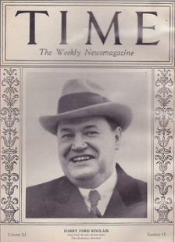
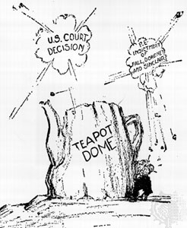
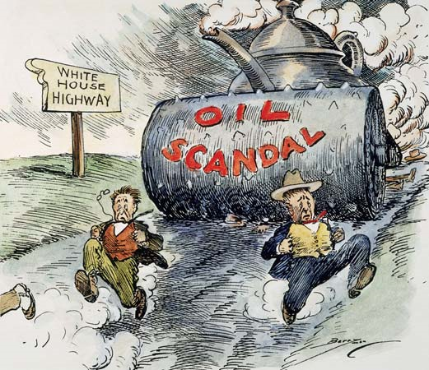
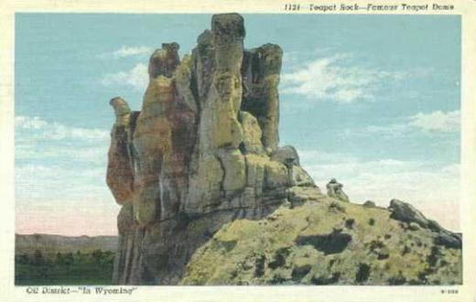
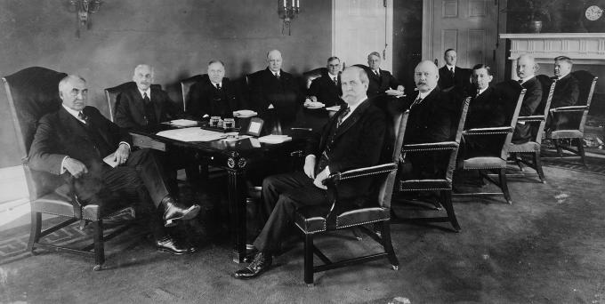

Slide 12
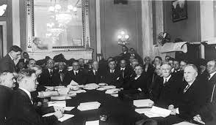
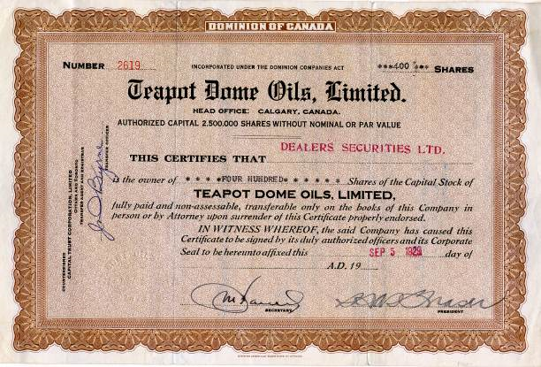

Slide 13
MLA Works Cited
"Graft and Oil: How Teapot Dome Became the Greatest Political Scandal of Its Time." Graft and Oil: How Teapot Dome Became the Greatest Political Scandal of Its Time. Web. 6 May 2015.
Shmoop Editorial Team. "The 1920s Timeline of Important Dates." Shmoop.com. Shmoop University, Inc., 11 Nov. 2008. Web. 6 May 2015.
"The Teapot Dome Scandal." The Teapot Dome Scandal. Web. 6 May 2015.

